Slide 1

2020-2021 AAI MSc Individual Research Project:
DataWise
2nd Progress Review
27/08/2021
Supervisors: Pr Weisi Guo and Dr Dimitrios Panagiotakopoulos

Slide 2
Outline
Introduction
I – Literature Review
Federated Learning
Research on Air Traffic System
II – Practical part
Problematic to solve & System flowchart
Data & ANN architecture
Results
III – Timeline and conclusions

Slide 3
Introduction
Initial project definition
Project goal: Analyze and reduce the data transfers in the existing Air Traffic Management (ATM) system in order to prevent future issues related to an increasing number of stakeholders and volume of data transferred
Increasing data volumes are costly and cause database queries to be slower
→ Potential security hazard
We want to find ways to reduce this ATM system using Artificial Intelligence

Slide 4
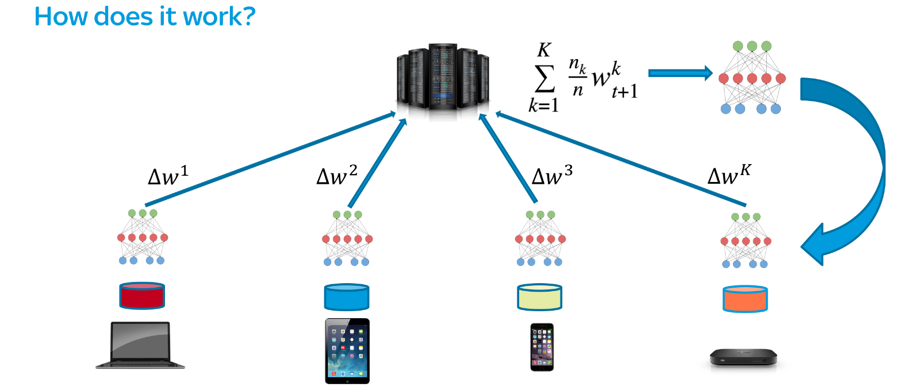
Lit. Review: Federated Learning
Federated Learning (FL) cycle illustration
Source: proandroiddev.com
Use case example : Speech prediction for mobile phones

Slide 5
Literature Review – Federated Learning
Common challenges associated with FL:
Communications
Systems heterogeneity
Statistical heterogeneity
Many ways to improve FL framework found in the literature
Discretization / sparsification of weights updates
Lossy weight compression
Low-rank weights matrix

Slide 6
Lit. Review: ATM system
Common challenges associated with the data in the ATM system:
Increasing data volumes transferred and stored
Longer query times
→ Solutions proposed in the literature
Novel database indexing technique
Automatic 4D data cleansing

Slide 7
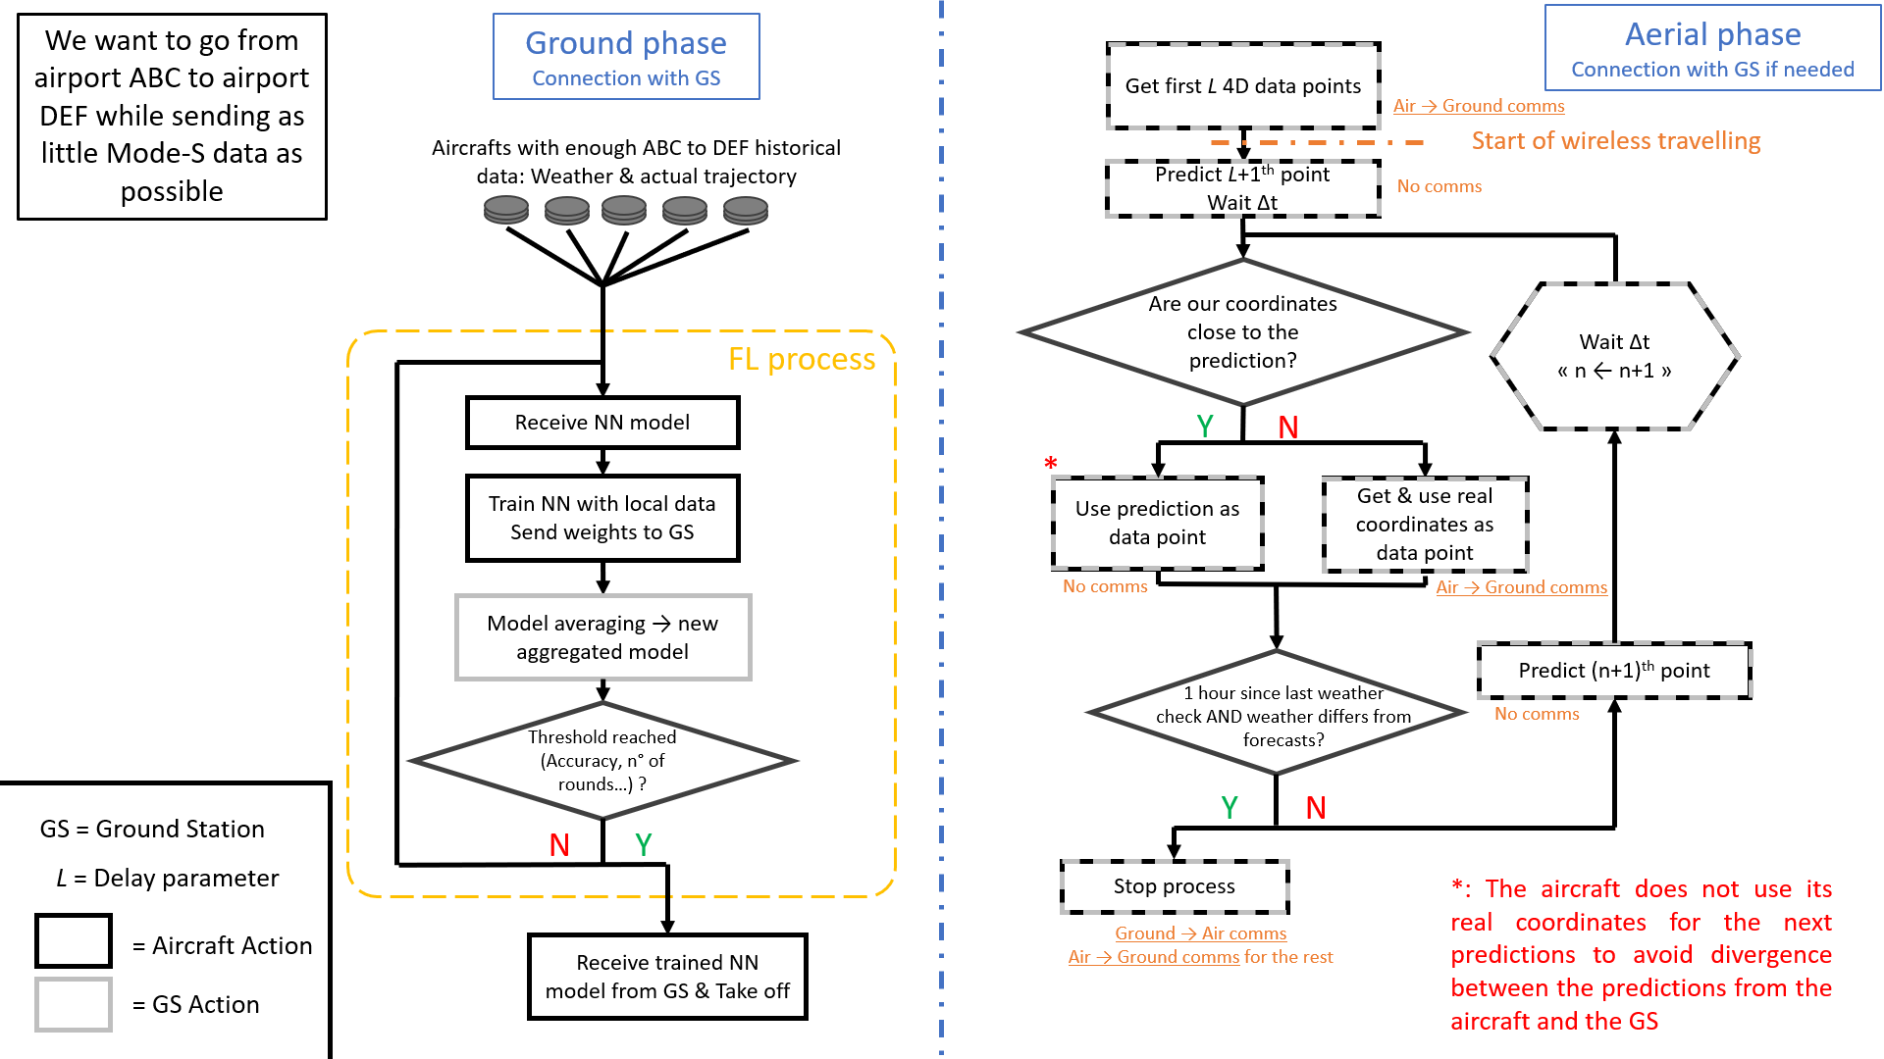
Practical part: Designed System Flowchart

Slide 8
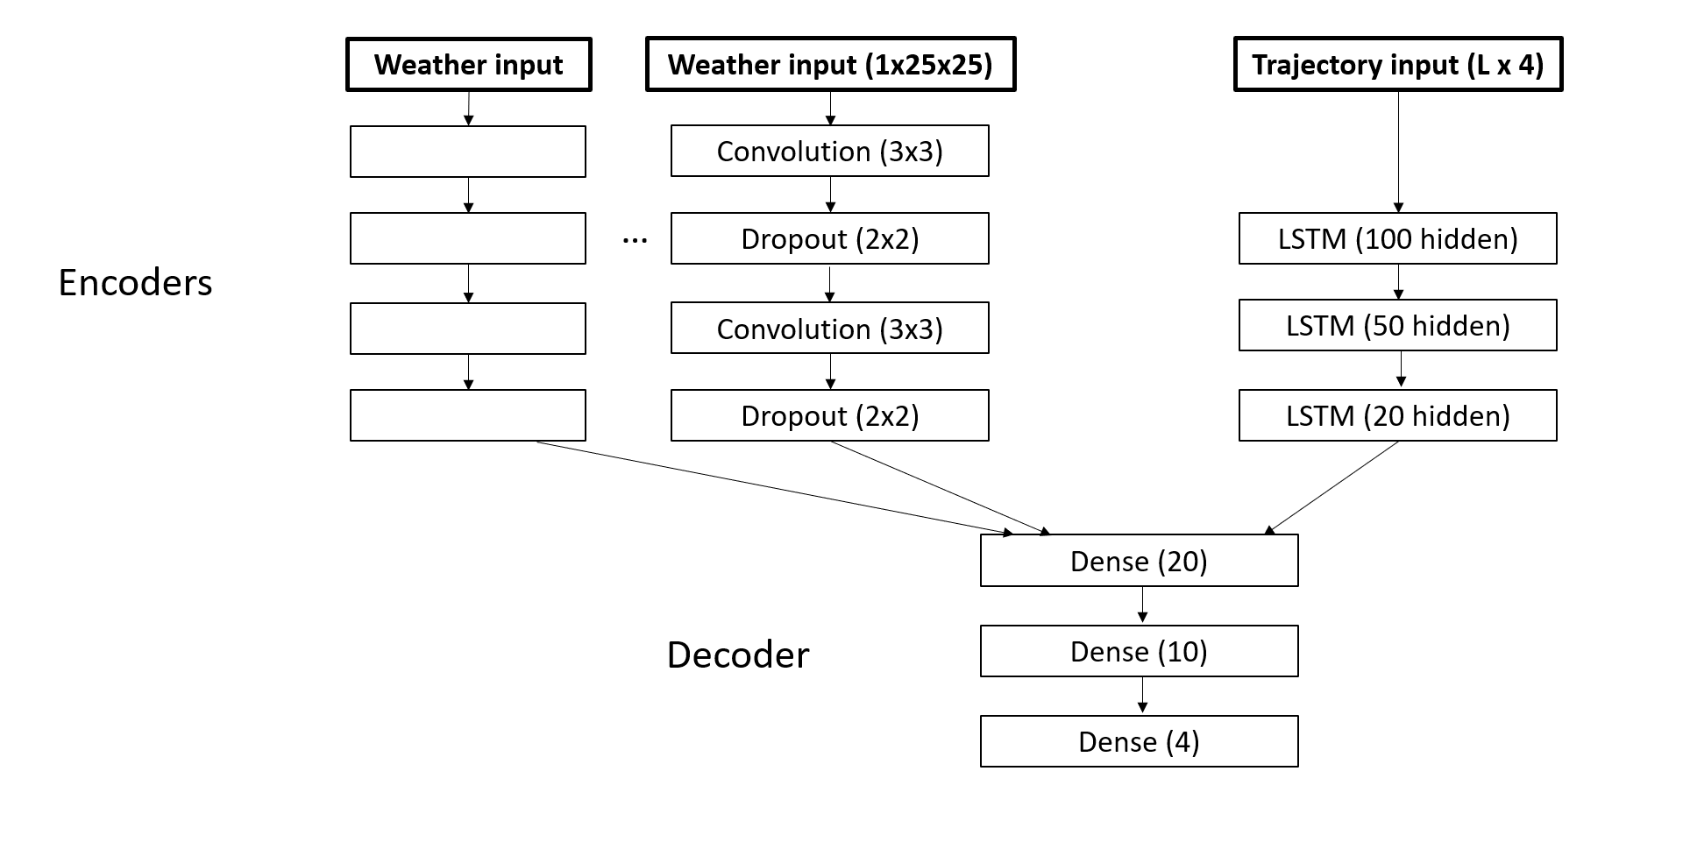
Details of the RNN architecture

Slide 9
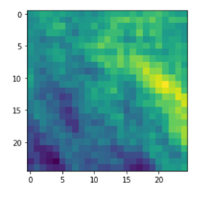
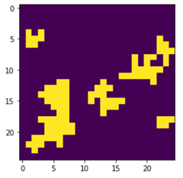
Data Sources
Aircraft trajectories: Github (Houston - Boston trajectories only)
Atmospheric & convective weather data: Randomly generated
Temperature map / Wind vector coordinates
Generated continuously
Air convective cells (binary map)
Generated in such a way that groups are formed

Slide 10
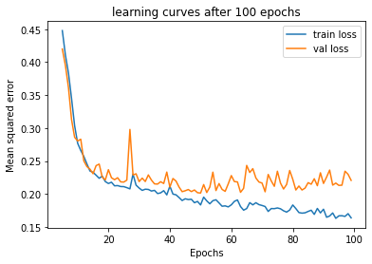
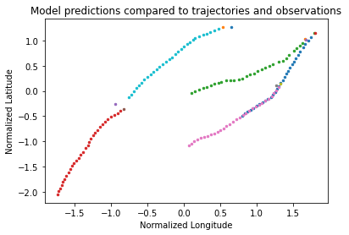
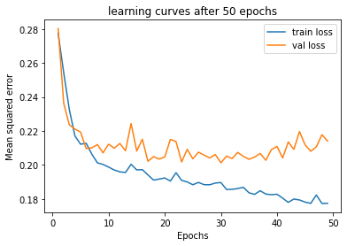
Results – Model predictions
Delay parameter = 20
Batch size = 500
Delay parameter = 30
100 epochs
500 batch size
Delay parameter = 30
Batch size = 125

Slide 11
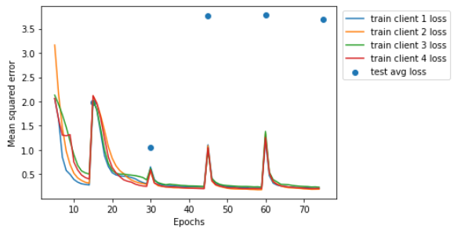
Results – Federated Learning
Parameters:
FL cycles: 5
N° of aircrafts: 4
Epochs per cycle: 15
Batch size: 256
Delay parameter: 30
DPs per client: ~2500
Learning curves for all training clients over all cycles, and test error on the resulting model

Slide 12
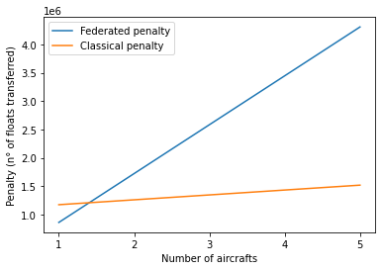
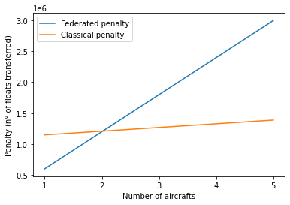
Results – Federated Learning
Penalties in number of float. numbers transferred as a function of the number of aircrafts taking part
Same plots after removing the seconf LSTM layer (45% of the model’s weights)
10% higher loss

Slide 13
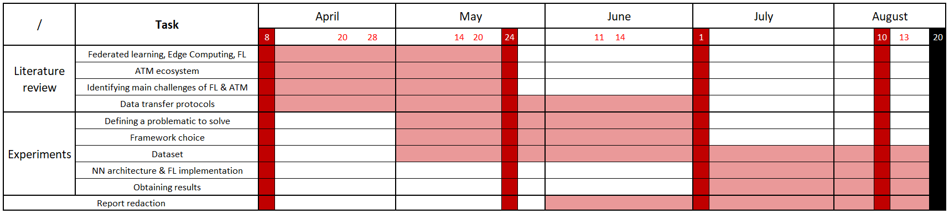
Timeline - Gantt chart

Slide 14
Conclusions and advice for future research
Great project to discover ATM & ML concepts such as FL and more
Practical implementation of neural network & FL framework quite challenging : Deep Learning module helped
Find the right architecture to obtain satisfying results
Find best trade-off between performance, model size and dataset size
Replace mock weather data by real data ; add more trajectories of the same path if available

Slide 15
Thank you!

